Slide 1
Storytelling
Session 07

Slide 2
Outline Material
Game Story
Key concepts
The storytelling engine
Linear stories
Nonlinear stories
Granularity
Advanced story
Case Study

Slide 3
Game Story
Stories are as old as communication itself.
Stories and games have been intertwined to varying degrees for almost as long.
Computer games generally have some sort of story attached to them as well. Sometimes it is a one-paragraph backstory, in other cases, it's a fully integrated story line where the game is the story.

Slide 4
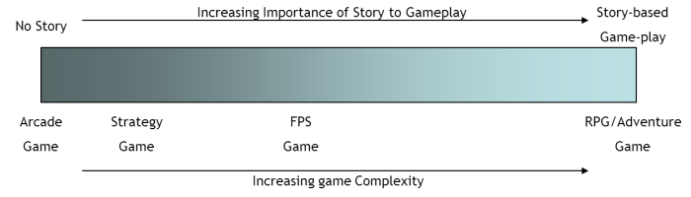
Key concepts
The use of stories in games is a fundamental part of game design.
A game without a story becomes an abstract construct.
Not all games require a detailed and rigorous story.

Slide 5
The storytelling engine
Weaves together the gameplay and the story
How does it work?
Receives triggers from the core mechanics to track the player’s progress
Presents each narrative block at the correct time
Sends triggers to the core mechanics when the current narrative block is done

Slide 6
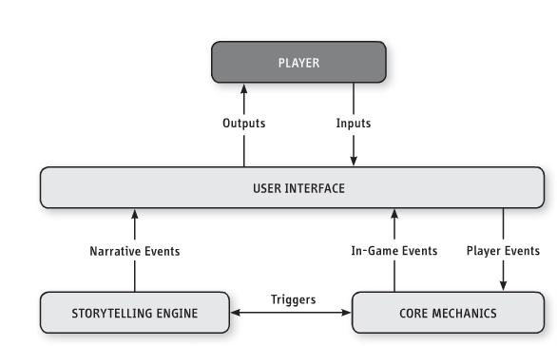
The storytelling engine

Slide 7
Linear stories
Player can’t change the story – no agency
Challenges are part of the story
Linear stories require less content than a non-linear.
Linear stories are less prone bugs and absurdities.
The storytelling engine managing a linear story has to keep track of only a single sequence of plot events.
Linear stories deny the player agency
Linear stories are capable of greater emotional power.

Slide 8
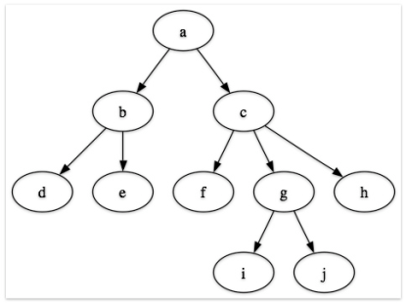
Non-Linear Story
Branching Story
Option of story and sometimes the endings.
Immediate, Deferred, and Cumulative influence.
There are challenges and Choices

Slide 9

Granularity
Granularity in the context of games that tell a story, refers to the frequency with which the game presents elements of the narrative to the player.
Large granularity reflects less frequent narrative blocks
Small granularity reflects more frequent narrative blocks

Slide 10
Advanced story
Story Tip #1: Goals, Obstacles, and Conflicts
A goal with no obstacles is not worth pursuing. Use this question to make sure :
What is the relationship between the main character and the goal? Why does the character care about it?
What are the obstacles between the character and the goal?
Is there an antagonist who is behind the obstacles? What is the relationship between the protagonist and the antagonist?
Do the obstacles gradually increase in difficulty?
Some say “The bigger the obstacle, the better the story. ” Are your obstacles big enough? Can they be bigger?
Great stories often involve the protagonist transforming in order to overcome the obstacle. How does your protagonist transform?

Slide 11
Advanced story
Story Tip #2: Provide Simplicity and Transcendence
To make sure you have the right mix of simplicity and transcendence, ask yourself these questions:
How is my world simpler than the real world? Can it be simpler in other ways?
What kind of transcendent power do I give to the player? How can I give even more without removing challenge from the game?
Is my combination of simplicity and transcendence contrived, or does it provide my players with a special kind of wish fulfillment?

Slide 12
Advanced story
Story Tip #3: Consider the Hero’s Journey
Many heroic stories have similar structure. Use this lens to make sure you haven’t missed out on any elements that might improve your story. Ask yourself these questions:
Does my story have elements that qualify it as a heroic story?
If so, how does it match up with the structure of the Hero’s Journey?
Would my story be improved by including more archetypical elements?
Does my story match this form so closely that it feels hackneyed?

Slide 13
Advanced story
Story Tip #4: Put Your Story to Work!
Story Tip #5: Keep Your Story World Consistent
Story Tip #6: Make your Story World Accessible
Story Tip #7: Use Clichés Judiciously
Story Tip #8: Sometimes a Map Brings a Story to Life

Slide 14
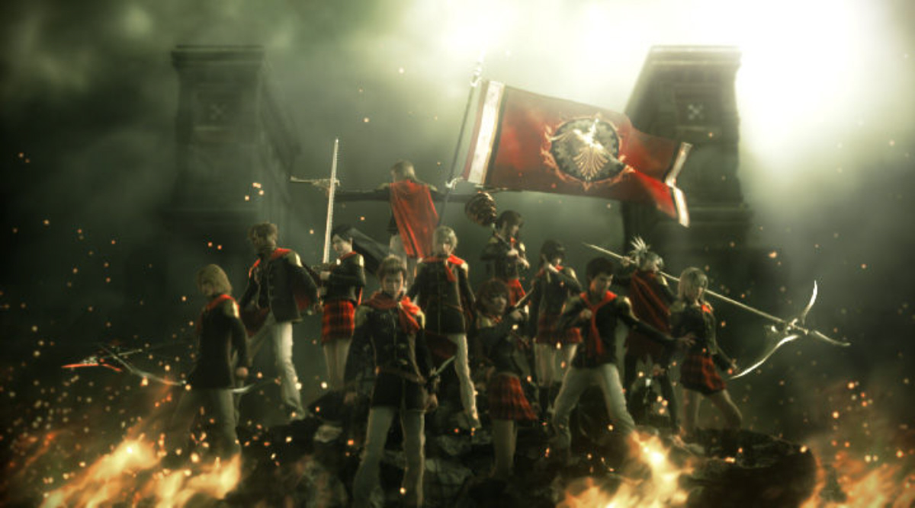
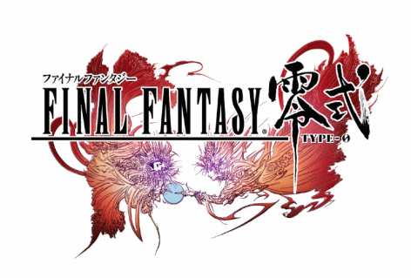
Case Study
Make a group of six and discuss about the following game story:

